Slide 1
Research Ethics Workshop
Dr Andre Samuel
andre.samuel@sam.edu.tt

Slide 2
Good News!
This module does not permit you to engage in primary research data
Since you are doing Desk-based Research i.e. using only secondary data:
  Data that is publicly available
  Publicly available data refers to datasets that can be accessed without special permissions or applications..
You do not have any ethical issues

Slide 3
ARU Online Ethics Training and Quiz
Compulsory for all Undergraduate and Masters students who plan to carry out research
https://anglia-ruskin-university.learnworlds.com/course/researchprofethics
You can use your Personal email to SIGN UP before you LOGIN
There is a quiz at the end of the training which needs to be successfully completed and confirmation of this submitted
The quiz can be attempted as many times as required.
Please submit Screenshot of Ethics Quiz Certificate in the Appendix of your final dissertation.

Slide 4
Defining Ethics in Research
Ethical concern will emerge as you carry out your research from planning, proposal, data collection and analysis and reporting results
Ethics is about actions that are valid in all circumstances
Your work will have an ethic attached to it that says something about you and your attitude
Your ethical standpoint could bias the work in unexpected ways and make it invalid

Slide 5
Formal Definition
“Ethics refers to the appropriateness of your behaviour in relation to the rights of those who become the subject of your work or who are affected by it”
    Saunders et al (2009, pg. 183-184)
“Ethics are norms or standards of behavior that guide moral choices about our behavior and our relationships with others”
    Cooper and Schindler (2006, pg. 116)

Slide 6
The Ethics Conundrum
Privacy
Informed Consent
Deception
Confidentiality

Slide 7
Overall Importance
In general ethics is concerned with how you treat participants in your research, how you collect data from participants and maintain confidentiality, and lastly how you analyse and report your findings
The goal is to ensure that no one is harmed or suffers adverse consequences from research activities
To avoid your research becoming ‘null and void’, unacceptable by norms, rescinded

Slide 8
General Ethical Issues
Privacy of possible and actual participants
Voluntary nature of participation and the right to withdraw
Consent and possible deception of participants
Maintenance of confidentiality of data
Reactions of participants to the way in which you seek to collect data
Effects on participants of the way data is used
Behaviour and objectivity of you as a researcher

Slide 9
It’s all about the Participants
Safeguards
  Explain study benefits
  Explain participant rights and protections
  Obtain informed consent
Avoid
  Deception
  Infringement of Privacy
  Confidentiality breaches

Slide 10
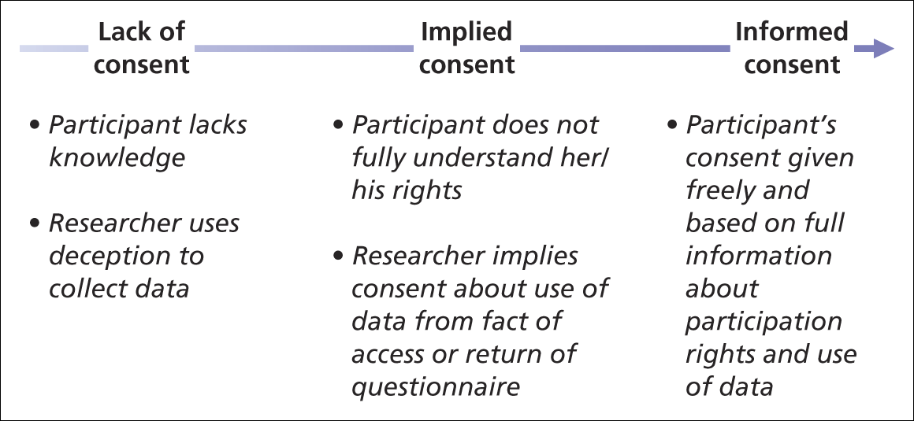
The Nature of Participant Consent

Slide 11
Rights to Privacy and Confidentiality
Protect Confidentiality by:
  Obtaining signed nondisclosure documents
  Restrict access to participant information
  Reveal participant info only with written consent
  Not disclosing data subsets
All individuals have a right to privacy and researchers must Respect that right
Privacy guarantee is important to retain validity of the research and
To encourage participants to answer truthfully

Slide 12
Data Protection
It is critical that you treat the data you have collected under the Data Protection Act and regulations
https://myaru.sharepoint.com/sites/student-office-for/SitePages/data-protection-in-research.aspx

Slide 13
Bibliography
Collis. J,, Hussey R (2003) Business Research 2nd edition, Palgarve Macmillan
Saunders, M., Lewis, P., Thornhill, A. (2007) Research Methods for Business Students, 4th edition, Prentice Hall
Salkind, N. (2003) Exploring Research, 5th Edition, Prentice Hall
Cooper, D.R., Schindler, P.S. (2006) Business Research Methods, McGraw-Hill
Ghauri, P and GrØnhaug, K. (2005) Research Methods in Business Studies, 3rd Edition, Pearson Education Limited

